Slide 1


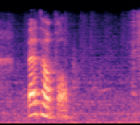
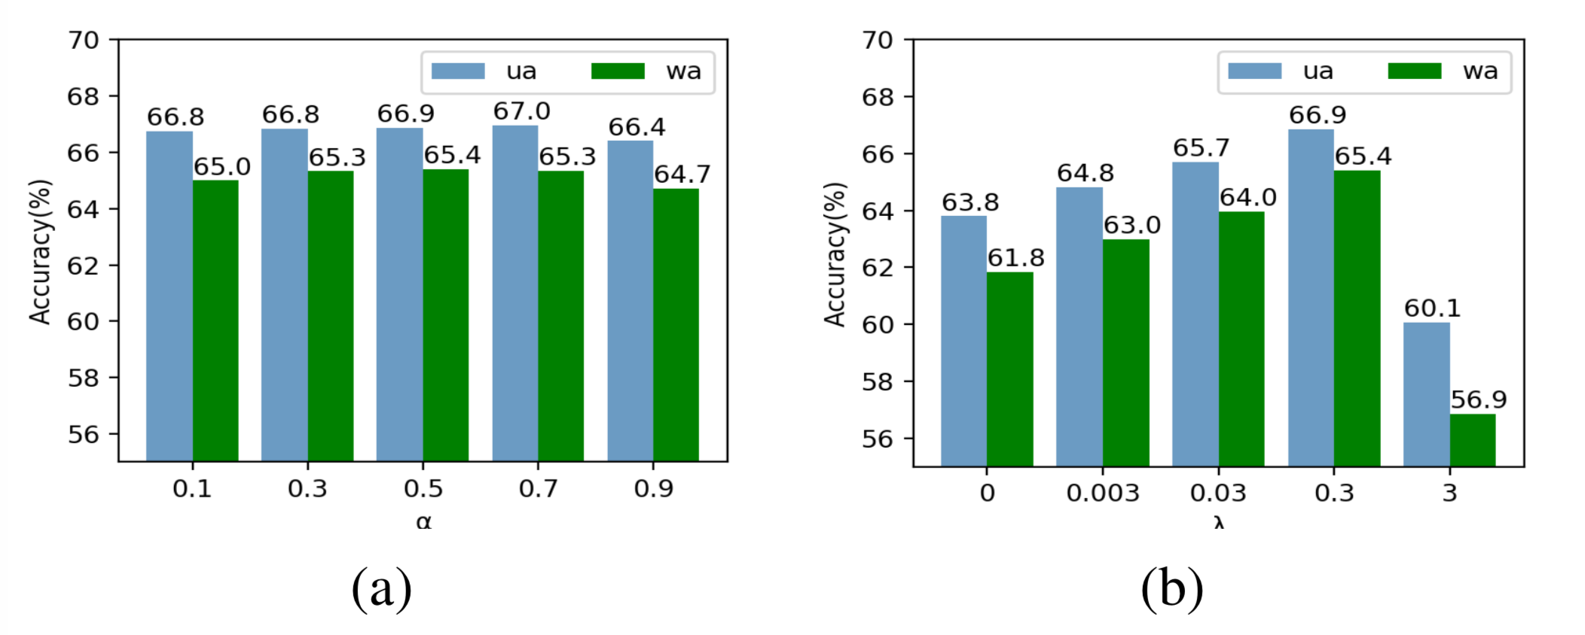
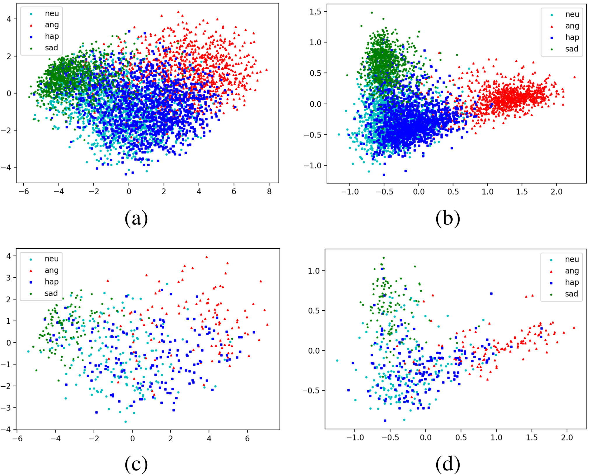
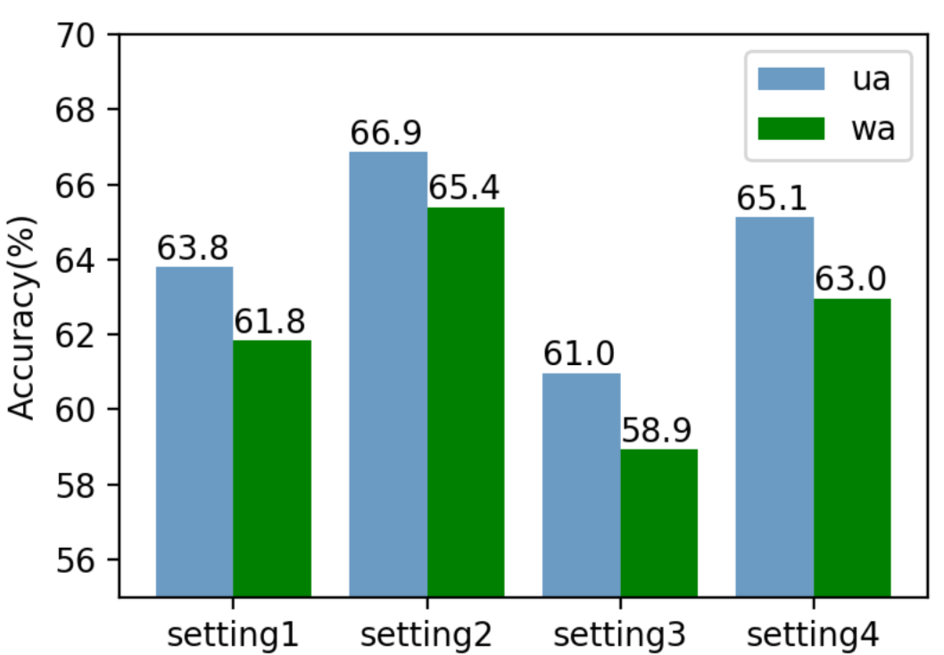
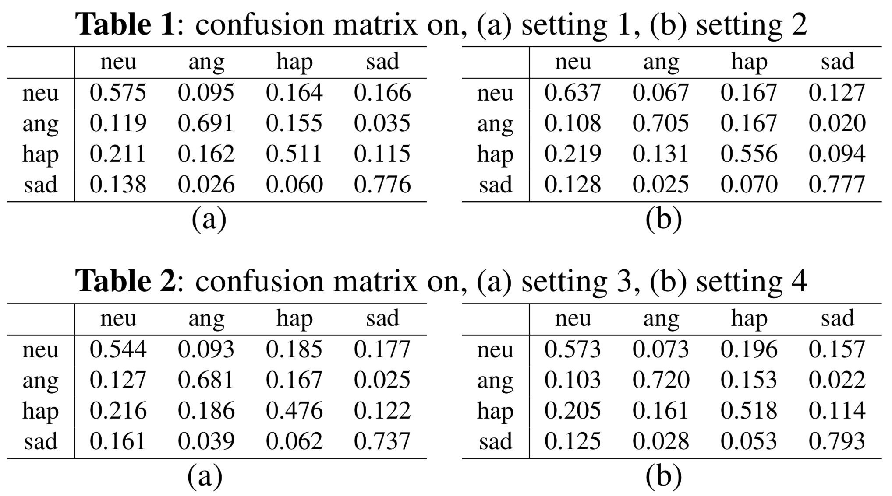


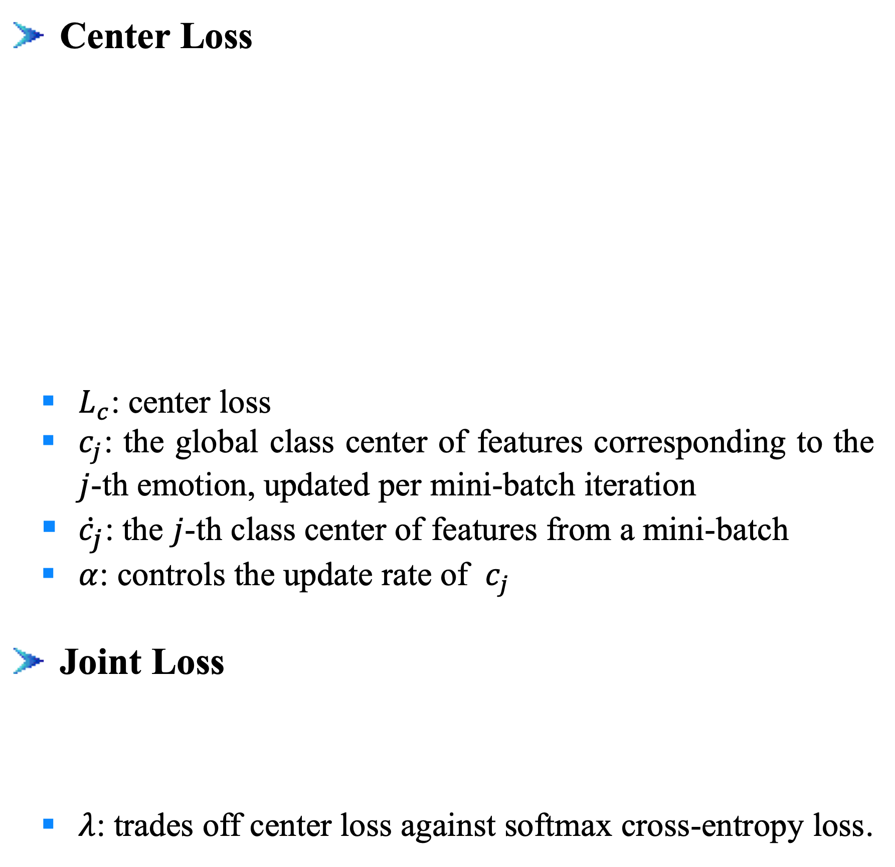
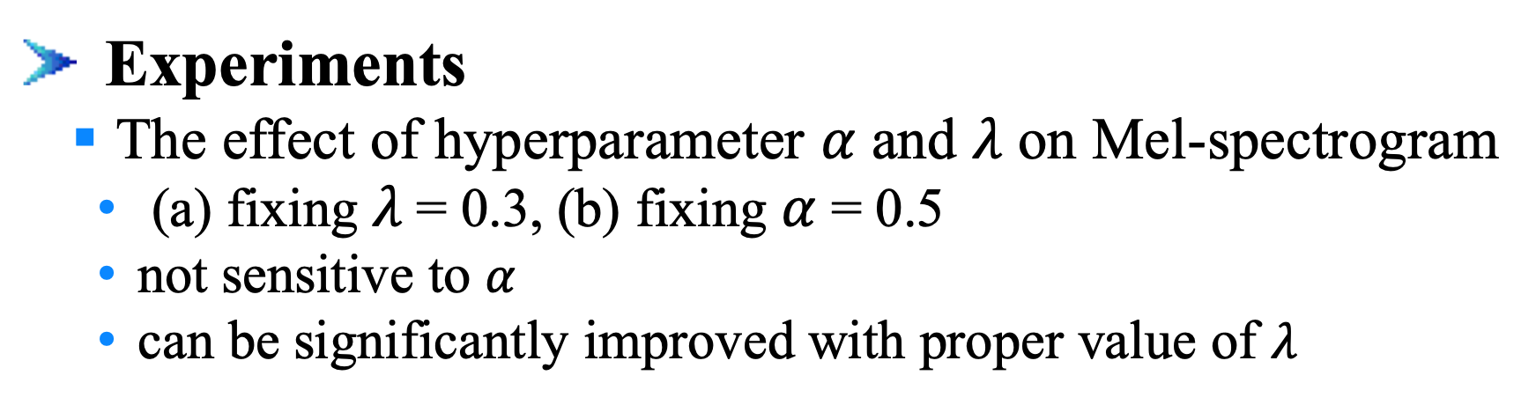
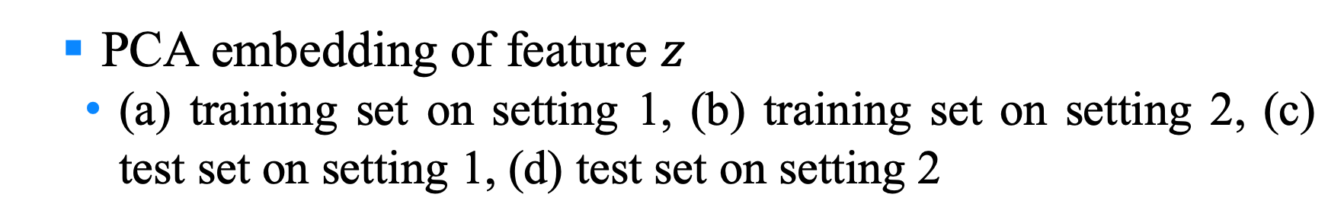






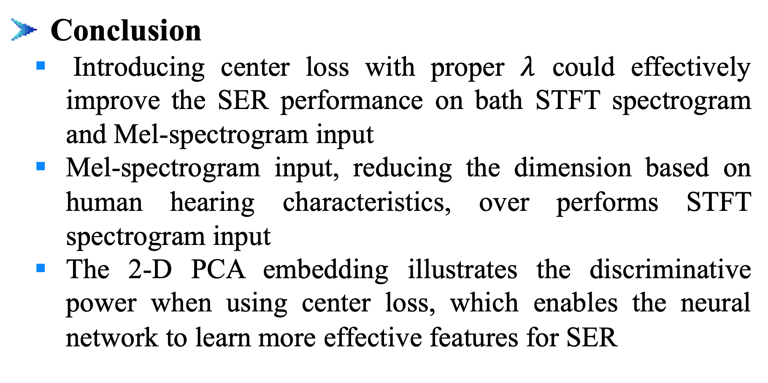

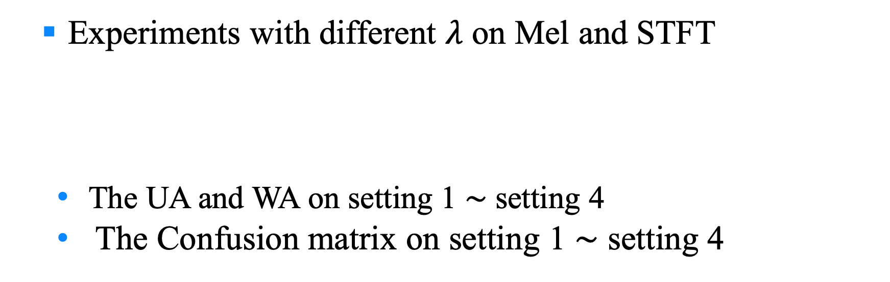


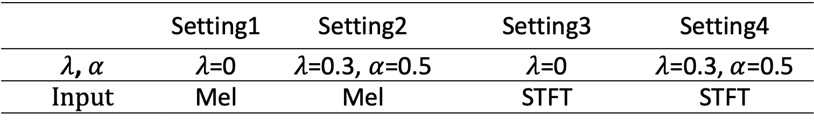


Learning Discriminative Features from Spectrograms using Center Loss for Speech Emotion Recognition
Dongyang Dai^{1,2}, Zhiyong Wu^{1,2,3}, Runnan Li^{1,2}, Xixin Wu³, Jia Jia^{1,2}, Helen Meng^{1,3}
¹Tsinghua-CUHK Joint Research Center for Media Sciences, Technologies and Systems, Graduate School at Shenzhen, Tsinghua University, Shenzhen, China ² Tsinghua National Laboratory for Information Science and Technology (TNList), Department of Computer Science and Technology, Tsinghua University, Beijing, China
³ Department of Systems Engineering and Engineering Management, The Chinese University of Hong Kong
1. Introduction
2. Proposed Method
Motivation
Identify the emotional state from speech
Center Loss
Model Architecture
Input: variable length spectrograms (STFT or Mel-spectrograms)
CNN layers: extract spatial information
Bi-RNN: compresses the variable length sequence down to a fixed-length vector
FC1: output $z∈R^{d}$as the learned feature and calculate center loss according to $z$
FC2: outputs posterior class probabilities, used to calculate softmax cross-entropy loss
Softmax Cross-enctropy Loss: enables the network to learn separable features
Center Loss: ﻿pulls the features belonging to the same emotion category to their center
Softmax Cross-entropy Loss
$ω_{j}$: ﻿in inverse proportion to the sample number of the $j$-th class in training set
Center Loss
$L_{c}$: center loss
$c_{j}$: the global class center of features corresponding to the $j$-th emotion, ﻿updated per mini-batch iteration
${\dot{c}}_{j}$: ﻿the $j$-th class center of features from a mini-batch
$α$: controls the update rate of $c_{j}$
Joint Loss
$λ$: ﻿trades off center loss against softmax cross-entropy loss.
$$z$$
+
Speech
Features
Emotion
Input
Softmax Cross-entropy Loss
CNN-layers
Bi-RNN
FC1
Challenge
Emotions are naturally ambiguous
How to extract features containing enough emotional information
Contribution
Introduce center loss together with softmax corss-entropy loss in SER task to learn discriminative features
Extract features and identify emotions directly from spectrograms
FC2
Reshape output: ${L′}_{T} ×d_{cnn} { (d_{cnn}=96⋅d′}_{T}$)
Reshape(Keep time axis)
2D convolutions output: ${L′}_{T} × L_{F}^{′}×$96
Max-pooling: 2 $×$ 2, strides [2, 2]
Concatenate
Convolution: 96 filters of 3 $×$ 3, strides [1, 1]
Max-pooling: 2 $×$ 2, strides [2, 2]
Convolution: 80 filters of 3 $×$ 3, strides[1, 1]
Max-pooling: 2 $×$ 2, strides [2, 2]
Convolution: 64 filters of 3 $×$ 3, strides [1, 1]
Convolution: 48 filters of 7 $×$ 7, strides [2, 2]
Input: spectrogram L_{T} $× L_{F}$
3. Experiments and Results
4. Conclusion
Experimental Setup
Data
Dataset: IEMOCAP
﻿Neutral, angry, happy, sad and excited (﻿merges happy and excited as happy, ﻿5531 utterances)
﻿﻿5 subsets (keep the emotion distribution), 4 subsets for training, half of the last subset as development set and half as test set
Settings of spectrograms
Model input: log scale STFT spectrogram or Mel-spectrogram
Hamming window
Window size: 40msec
Window Shift: 10msec
Sample rate： 16KHz
DTF length: 1024
The number of Mel bands: 128
Metrics
The unweighted accuracy: UA, the mean value of the recall for each class
The weighed accuracy: WA, the number of correctly classified samples divided by the total amount of samples
Experiments
The effect of hyperparameter $α$ and $λ$ on Mel-spectrogram
﻿(a) fixing $λ$= 0.3, (b) fixing $α$= 0.5
﻿not sensitive to $α$
﻿can be significantly improved with proper value of $λ$
Conclusion
Introducing center loss with proper $λ$ could effectively improve the SER performance on bath STFT spectrogram and Mel-spectrogram input
Mel-spectrogram input, reducing the dimension based on human hearing characteristics, over performs STFT spectrogram input
﻿The 2-D PCA embedding illustrates the discriminative power when using center loss, ﻿which enables the neural network to learn more effective features for SER
﻿﻿ Experiments with different $λ$ on Mel and STFT
﻿The UA and WA on setting 1 $∼$ setting 4
The Confusion matrix on setting 1 $∼$ setting 4
﻿﻿ PCA embedding of feature $z$
﻿(a) training set on setting 1, (b) training set on setting 2, (c) test set on setting 1, (d) test set on setting 2
 | Setting1 | Setting2 | Setting3 | Setting4
﻿$λ$,$α$ | $λ$=0 | $λ$=0.3,$α$=0.5 | $λ$=0 | $λ$=0.3,$α$=0.5
﻿Input | Mel | Mel | STFT | STFT
5. Acknowledgment
This work is supported by National Natural Science Foundation of China (NSFC) (61433018, 61375027), joint research fund of NSFC-RGC (Research Grant Council of Hong Kong) (61531166002, N CUHK404/15) and National Social Science Foundation of China (13&ZD189)

